Slide 1
Biomedical HIV prevention methods for adolescents and women
UZ-UCSF
Annual Research Day
8 April 2016

Slide 2
Adolescents, young people and HIV
The largest generation ever of people aged 12-24 years (1.6 billion)
Adolescence is a period marked by rapid developmental, emotional and social changes
In 2010, 42% of new HIV infections were in young people aged 15-24yr
~80% (4mill) live in sub-Saharan Africa
Population based surveys in L&MIC
Low knowledge levels about HIV prevention and transmission
UNAIDS Factsheet 2012
Notes:
Only 24% of young women and 36% of young men responded correctly when asked 5 questions on HIV prevention and transmission

Slide 3
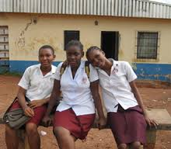
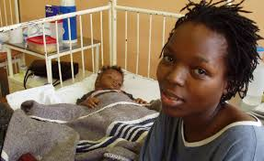
Gender inequalities
Globally, HIV infections in young women aged 15-24 are 2x as high as in young men
Biological susceptibility to HIV infection
Older sexual partners
Partners using IV drugs
Early marriages
Against their will
violence

Slide 4
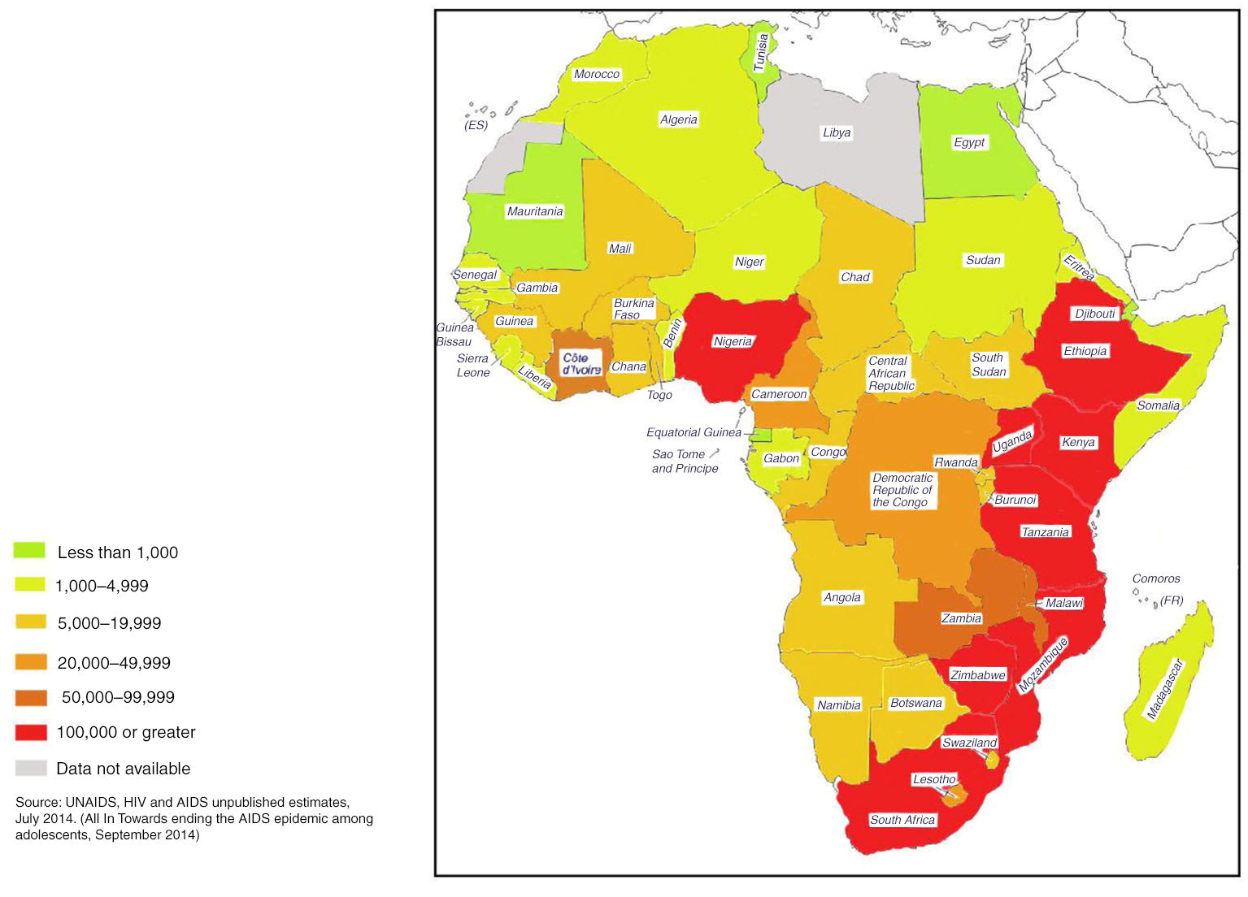
Ending the AIDS epidemic among adolescents UNAIDS 2014
Notes:
100 000 or more in the red

Slide 5
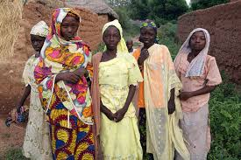
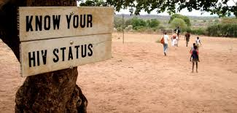
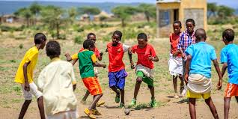
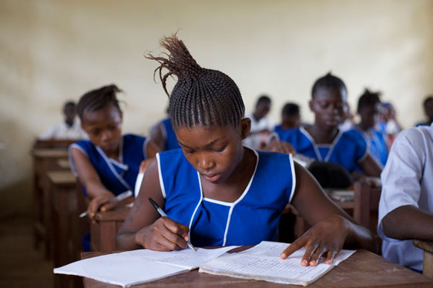
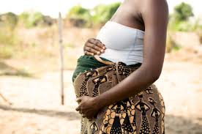
Navigating HIV in adolescents

Slide 6
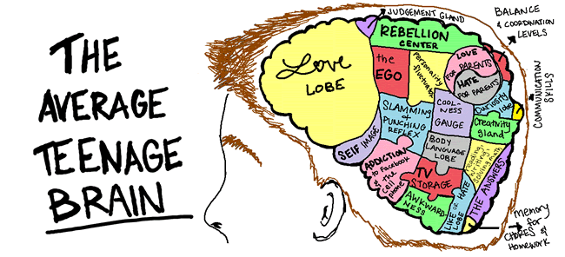
Notes:
As we consider HIV prevention and treatment in adolescents, it will be important to take some time to consider the brain that we are dealing with and where interventions such as education, delayed sexual debut, consistent condom use, Dapivirine ring and any other ring, preventing HIV acquisition etc.
Of note is that there is no area for health, but there is a corner for ‘have no idea’
Locally one could add to the hip hop corner, Zim dance hall

Slide 8
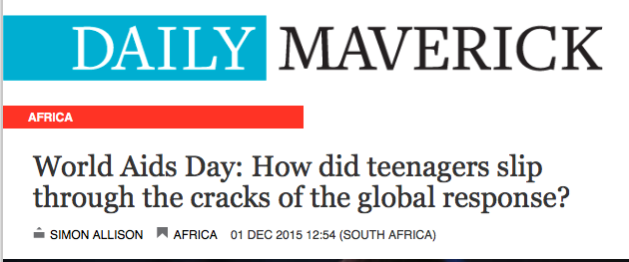
Navigating HIV in adolescents and young people

