Slide 1
HPTN 082
Uptake and adherence to daily oral PrEP as a primary prevention strategy for young African women:
A Vanguard Study

Slide 2
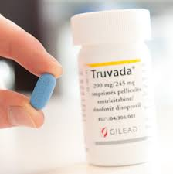
HPTN 082
Purpose - to assess acceptability and adherence of oral pre-exposure prophylaxis (PrEP) among HIV-uninfected young women (16-25yrs) in Southern Africa.
Study size - 400 young women who accept PrEP at enrollment and up to 200 young women who decline PrEP at enrollment.
PrEP regimen - Once daily oral Truvada (FTC/TDF).
Notes:
A Phase IV randomized multi-site prospective study to assess PrEP acceptance and adherence among HIV-uninfected young women.
Study sites – Spilhaus - Harare, Emavundhleni – Cape Town, Wits – Johannesburg

Slide 3
Study Design
All women who accept open-label daily oral PrEP will be randomized 1:1 to receive enhanced adherence counselling based on feedback from observed drug levels or standard adherence support.
A subset of up to ~25 women per site (maximum 75), will participate in qualitative assessments of facilitators and barriers for PrEP acceptance, adherence and continuation.
Notes:
PrEP decliners are allowed to change to receive PrEP

Slide 4
Qualitative interviews (25 per site, 75 total)
Sample women who have high or low adherence based on drug levels at 1 & 2 months and initial PrEP decliners about:
Factors that influence women’s uptake of PrEP
Factors that influence her adherence to PrEP (e.g., storage of product, disclosure, communication with partner, alcohol & drug use)
Among those randomized to get drug level feedback, their experience & how feedback influenced subsequent PrEP adherence
Notes:
A subset of up to ~25 women per site (maximum 75), will participate in qualitative assessments of facilitators and barriers for PrEP acceptance, adherence and continuation.

Slide 5
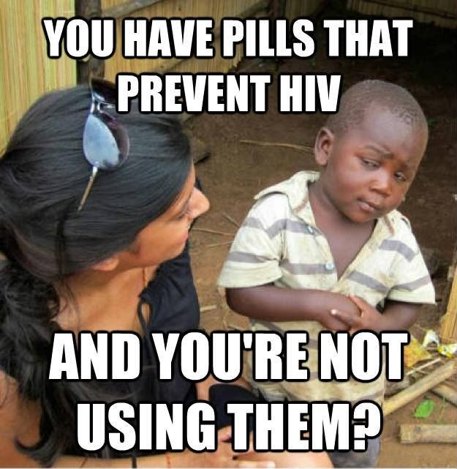
Notes:
HPTN 082 is asking this question to young women
Thank you

