Slide 1
IMPAACT 2009 Pharmacokinetics, Feasibility, Acceptability, and Safety of Oral Pre-Exposure Prophylaxis for Primary HIV Prevention during Pregnancy and Breast Feeding in Adolescents and Young Women
A protocol in development
IMPAACT Prevention Scientific Committee
Notes:
Welcome to IMPAACT 2009 – a protocol in development by the HIV Prevention Scientific Committee. This presentation provides a brief overview of the protocol. The latest protocol draft was circulated earlier – your comments are vital to ensure scientific relevance and operational efficiency.

Slide 2
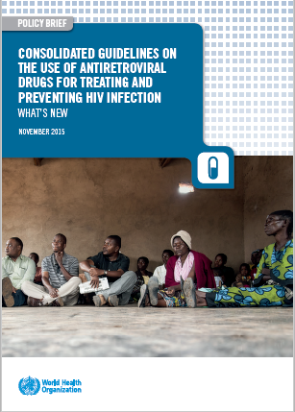
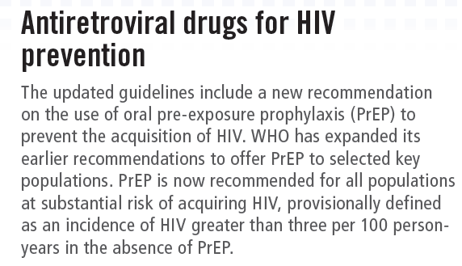
PrEP WHO guidelines
Substantial risk = incidence rate of > 3.0 per 100 person-years
Notes:
The WHO 2015 guidelines now include the use of antiretroviral drugs for HIV prevention for all populations at substantial risk of acquiring HIV, those with an incidence of HIV >3/100 p yrs. This expands the previous recommendation for PrEP in key populations identified; sero-discordant couples, commercial sex workers, MSM and IDUs.

Slide 3
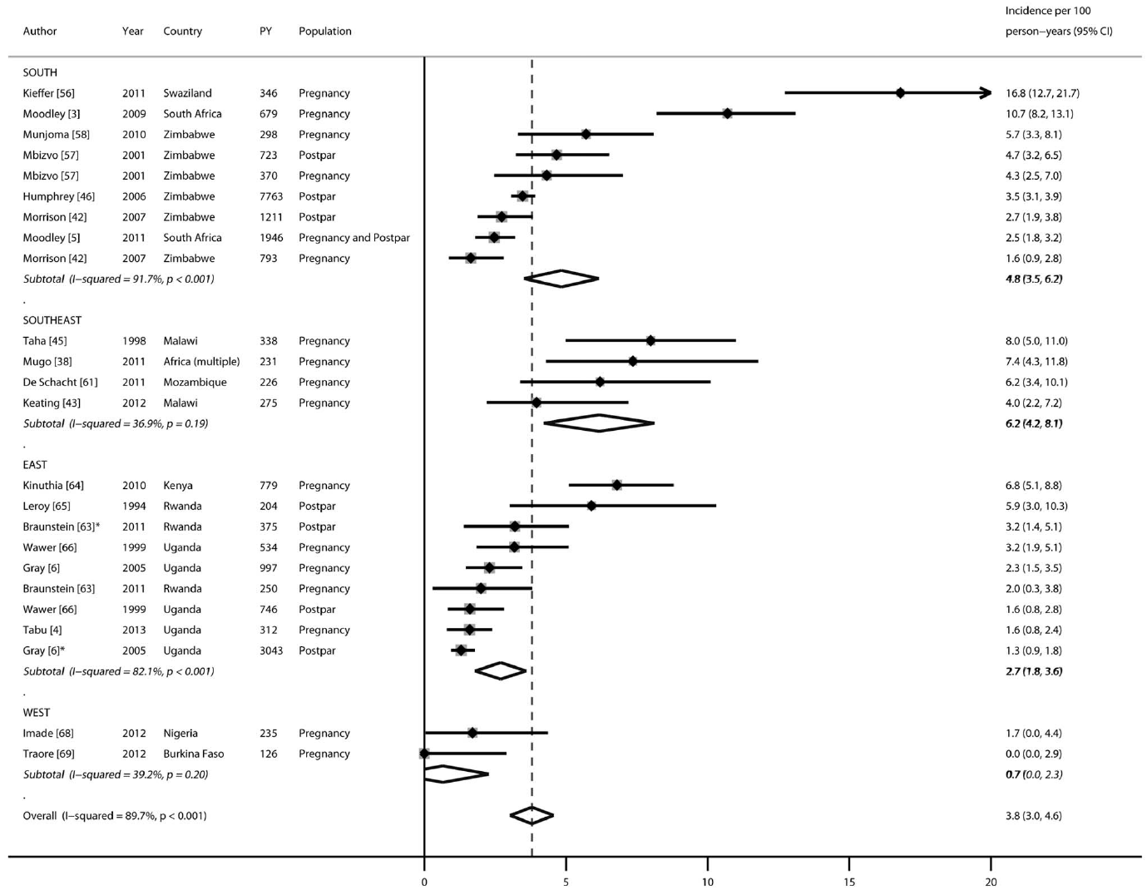
Cumulative incidence in pregnant/postpartum women:
3.8 per 100 person-years
(95%CI: 3.3–6.1)
In comparison:
“Key populations” incidence
2.7-6.1 /100 person-years
Drake, PLoS Med 2014
Notes:
Examining HIV incidence in pregnant and postpartum populations in Drake’s metanalysis of 2014, we see that the cumulative incidence across studies was 3.8/100 p yrs.

Slide 4
There are currently few interventions being implemented to help women to remain HIV-free during pregnancy, breastfeeding and beyond. More effort is needed to address this gap. This may be particularly important for adolescent women, who may have less experience with and information about HIV.
UNAIDS Gap Report 2014
Notes:
And we were reminded in the UNAIDS Gap Report of 2014 of the need to develop HIV prevention strategies for pregnant women, providing the rationale for this trial – IMPAACT 2009.

Slide 5
Primary Objectives
To characterize PrEP adherence among HIV-uninfected women aged 16-24 years who initiate once-daily TDF-FTC from <32 weeks to 6 months postpartum
To compare maternal and infant adverse events (including pregnancy outcomes) between women who initiate PrEP and those who decline PrEP

Slide 6
Secondary Objectives
To identify individual, social, and structural barriers and facilitators to PrEP uptake during pregnancy
To compare reported sexual risk behavior and incidence of sexually transmitted infections between the PrEP and non-PrEP cohorts
To compare HIV incidence in women between the two cohorts
To compare HIV drug resistance in HIV-infected mothers and infants from the two cohorts

Slide 7
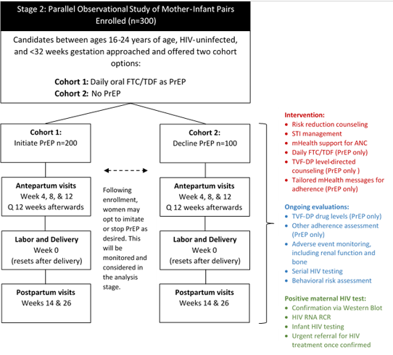
Cohort component
Notes:
This is the current study schema.
IMPAACT 2009 is a parallel observational study of mother-infant pairs where daily oral FTC/TDF is offered to HIV-uninfected pregnant women. Those who choose to initiate PrEP in pregnancy are enrolled in cohort 1 – there will be 200 of them. Those who decline the offer are enrolled in cohort 2 – only 100 women in this cohort. There are study visits at antepartum weeks 4, 8 and 12 and then every 12 weeks while still pregnant, a L&D visit with the infant, then postpartum visits at weeks 14 and 26. Both cohorts will be monitored for adverse events (including renal function and bone health), have serial HIV testing and behavioural risk assessments. Women may opt to initiate or stop PrEP as desired.

Slide 8
Study endpoints
Pregnancy?
Adherence
Tenofovir disoproxil fumarate-diphosphate (TFV-DP) levels measured through dried blood spots.
Safety (maternal and infant)
Adverse pregnancy outcomes will include a composite of the following:
Stillbirth
Birthweight <2500 g
Preterm delivery of less than 37 weeks gestation
Maternal AE outcome will be a composite of the following:
Grade 3 or higher signs and symptoms
Grade 2 or higher chemistry abnormalities
Grade 3 or higher pregnancy-related diagnosis
Notes:
However, the many physiological changes of pregnancy affect the way drugs are handled by the body and there are no pharmacokinetic data for TFV-DP in pregnancy. This information is needed for the adherence counselling sessions, so a PK lead-in stage was added to IMPAACT 2009.

Slide 9
