Slide 1
Update on HPV research agenda
N R Manyere
UZ, College of Health Sciences
Department of Obstetrics and Gynaecology

Slide 2
Human papillomavirus (HPV)
HPV is a virus that infects humans and causes diseases. It is the commonest sexually transmitted viral infection.
More than 150 types of HPVs have been identified in humans and about 40 are sexually transmitted and infect the genital tract.

Slide 3
Chronic HPV infection causes genital warts which are benign and cancers of the genital tract ie,
cervix, vagina, vulva and anus
Burden of HPV related cancer is high in women especially cancer of the cervix
In Zimbabwean black women the commonest cancers are cervical cancer (32%), breast (12%) and Kaposi Sarcoma (6.9%) ; 1 in every 3 women with cancer has cervical cancer. [Zim cancer registry 2013]

Slide 4
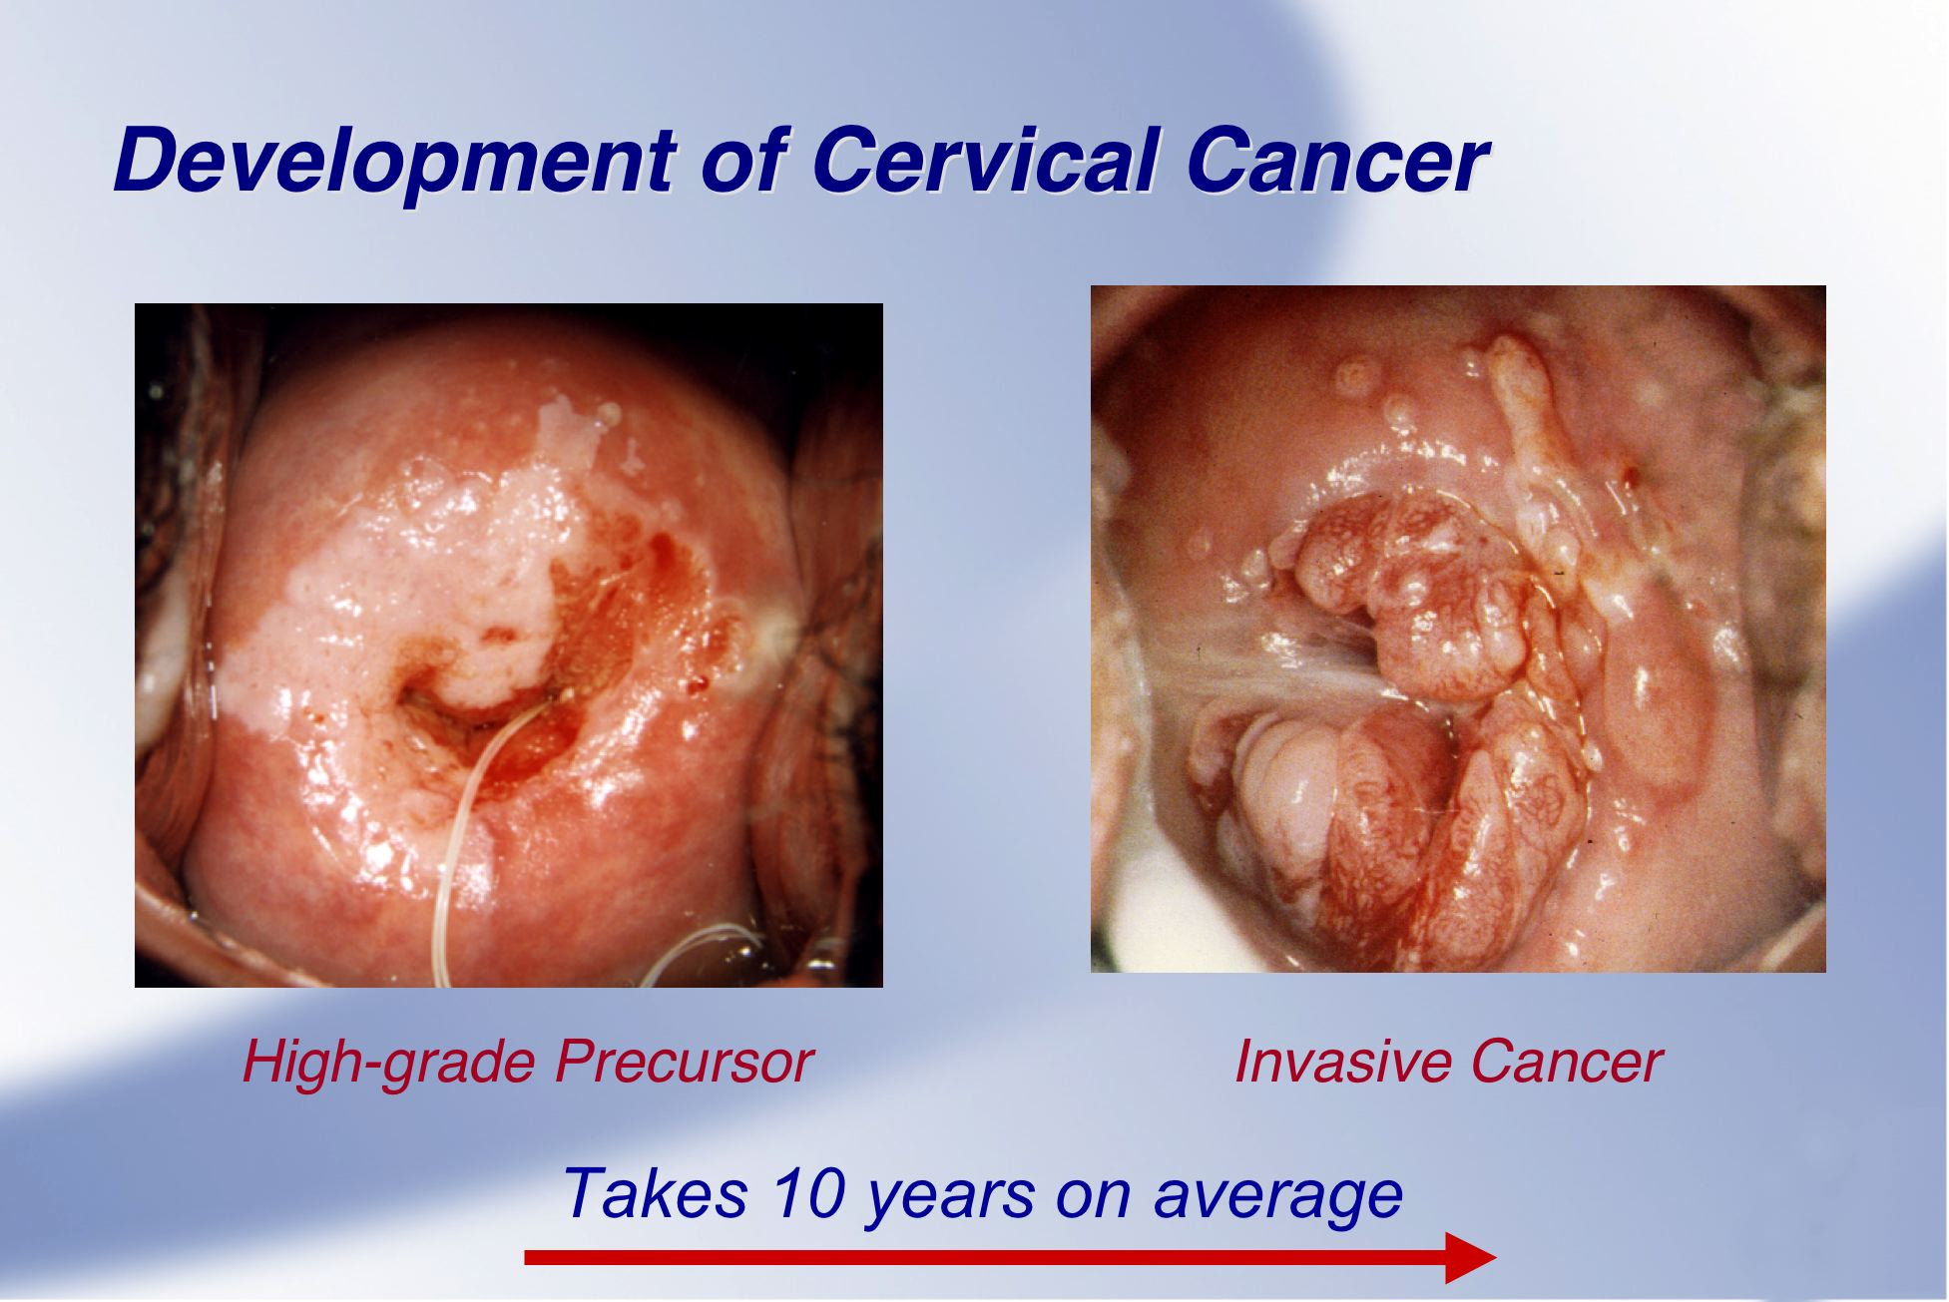

Slide 5
Primary Prevention of Cervical Cancer
Cervical cancer is preventable
A vaccine against HPV infection has been available since 2006
Zimbabwe has successfully completed an HPV vaccination pilot project in 2 districts. The vaccine targets 2 cancer causing HPVs; 16 and 18
The Ministry of Health has plans to roll out the national HPV vaccination programme in 2016

Slide 6
UZ-UCSF coordinated HPV research
UZ-UCSF in collaboration with UCSF set up the first HPV testing and typing facility in Zimbabwe in an attempt to find out the HPV types affecting our population.
2 lab scientists have received specialist training at UCSF in HPV typing
HPV testing and typing started in March 2014

Slide 7
Research concepts
1)The different types of HPV causing abnormal cells that give rise to cancer in the anus in HIV positive adults attending the Opportunistic Infections Clinics (Simba Chinyowa)
2) The different types of HPV among women presenting for cervical cancer screening (Racheal S Dube-Mandishora)
3) Different types of HPV in genital warts among women in Harare-Zimbabwe (Ngatendwe Manyere)
4) Different types of HPV in women with cervical cancer (Washington Mudini)
5) Different types of HPV in vulva or vaginal cancer (Thulani Magwali)

Slide 8
Summary of the study on HPV types in genital warts
as part of the HPV research agenda
Objective To determine the HPV types in women with genital warts presenting at Harare, Parirenyatwa and Wilkins hospitals

Slide 9
We enrolled 100 women who were 18 years or older and had genital warts
We collected tissue from the participants and tested for HPV

Slide 10
Demographic characteristics(N=100)
Characteristic
Mean age (years) |  | 30.3
Mean age at sexual debut (years) |  | 19
Marital status | Married | 29
 | Divorced/ Widowed | 50
Mean parity |  | 1.93
Mean number of sexual partners |  | 4.3
HIV status | HIV positive | 78
 | HIV negative | 19
Median CD4 count (cells/mm³) |  | 293.5 (188; 473)
Notes:
Occupation: Formally employed – 32, Self employed – 25, Unemployed – 33

Slide 11
HPV types
98% of participants had 1 0r more HPV types detected
43% had a single HPV type
29% had a mixture of cancer causing and non-cancer causing types
83% had type 6 and/or 11 which are known to cause genital warts
Type 16 which is part of the vaccine was in 14% and 18 which is also covered by the vaccine was found in 2% of participants
18% had cancer causing types that are not covered by the vaccine(51,33,31,58,45,52,59,66)

Slide 12
Conclusion
Among women with genital warts 98% have a detectable HPV type
As expected types 6 and/11 constituted 83% of the HPV types.
34% had cancer causing HPV

Slide 13
Acknowledgements
We are grateful to the collaborative effort of UZ-UCSF and UCSF which has created the first HPV research laboratory in Zimbabwe

Slide 14
Thank you
For and on behalf of the HPV research group

Slide 15
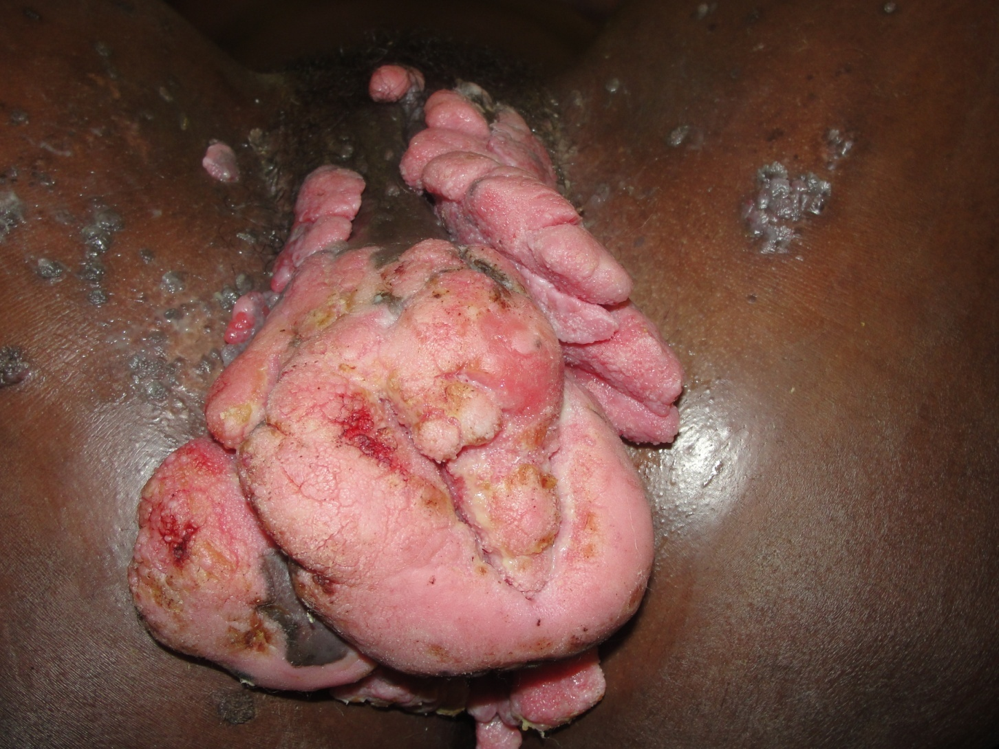
Genital Warts in HIV infected Woman

Slide 16
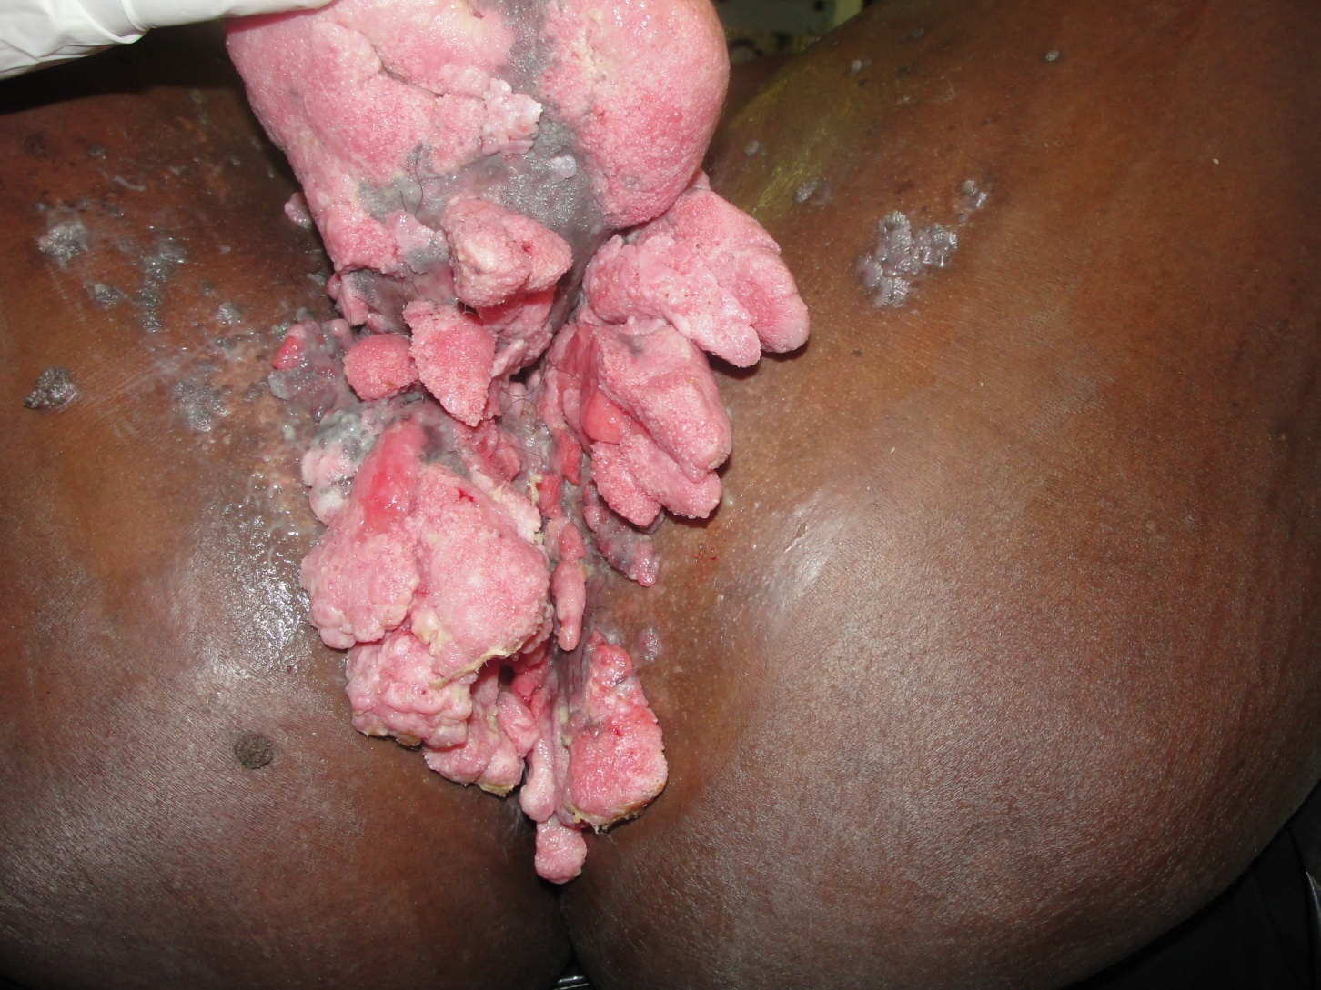
Genital Warts in HIV infected Woman

