Slide 1
Enhanced infection prophylaxis reduces mortality in severely immunosuppressed HIV-infected adults and older children initiating antiretroviral therapy in Kenya, Malawi, Uganda and Zimbabwe: the REALITY trial
Dr G Musoro and the REALITY trial team

Slide 2
Background
Mortality is high in the first 6 months among HIV-infected adults and children initiating ART with advanced disease with severe immunosuppression in sub-Saharan Africa¹⁻³
Causes of death include tuberculosis, other bacterial, fungal (cryptococcus) and protozoal infections
It is unknown whether an enhanced package of infection prophylaxis at time of ART initiation would reduce mortality
REALITY trial (ISRCTN43622374) in Uganda, Zimbabwe, Malawi and Kenya
1) Braitstein et al. Lancet 2006. 2) Cornell et al. AIDS 2010. 3) Walker et al. CID 2012

Slide 3
Design
ART-naïve HIV-infected adults & children >5 years with CD4<100 cells/mm³
1:1 randomisation
Enhanced prophylaxis: CTX* +
12 weeks INH/B6* 300/25mg/d (anti-TB)
12 weeks fluconazole 100mg/d (anti-fungal)
5 days azithromycin 500mg/d (anti-bacterial & anti-protozoal)
single-dose albendazole 400mg (anti-helminth)
Standard prophylaxis: CTX
(most received additional INH/B6* from 12 weeks depending on national guidelines)

Slide 4
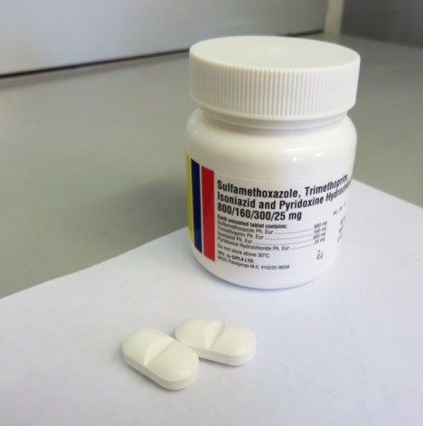
Design
ART-naïve HIV-infected adults & children >5 years with CD4<100 cells/mm³
1:1 randomisation
Enhanced prophylaxis: CTX* +
12 weeks INH/B6* 300/25mg/d (anti-TB)
12 weeks fluconazole 100mg/d (anti-fungal)
5 days azithromycin 500mg/d (anti-bacterial & anti-protozoal)
single-dose albendazole 400mg (anti-helminth)
Standard prophylaxis: CTX
(most received additional INH/B6* from 12 weeks depending on national guidelines)
*INH/B6/CTX scored FDC
Half doses if <12 years
Produced by Cipla Pharmaceuticals Ltd

Slide 5
Design
ART-naïve HIV-infected adults & children >5 years with CD4<100 cells/mm³
1:1 randomisation
Enhanced prophylaxis: CTX* +
12 weeks INH/B6* 300/25mg/d (anti-TB)
12 weeks fluconazole 100mg/d (anti-fungal)
5 days azithromycin 500mg/d (anti-bacterial & anti-protozoal)
single-dose albendazole 400mg (anti-helminth)
Standard prophylaxis: CTX (most received additional INH/B6* from 12 weeks depending on national guidelines)
*INH/B6/CTX scored FDC
Half doses if <12 years
Follow-up to week 48
Safety bloods at screening, weeks 4 and 48; FBC & CD4 at weeks 0, 12, 24, 36, 48; Viral loads retrospectively at weeks 0, 4, 12, 24, 48
Two other factorial randomisations investigated
12 weeks adjunctive raltegravir (FRAB0102LB)
12 weeks supplementary food
Primary endpoint: 24-week mortality

Slide 6
Baseline characteristics n (%) or median (IQR)
Characteristic | Enhanced Px (N=906) | Standard Px (N=899)
Male | 477 (53%) | 484 (54%)
Age (years) | 36 (29-42) [6-71] | 36 (30-42) [5-78]
5-17 years | 39 (4%) | 33 (4%)
Current TB disease | 122 (13%) | 125 (14%)
WHO stage 1 or 2 | 436 (48%) | 418 (46%)
CD4 (cells/mm³) | 38 (16-64) | 36 (16-60)
0-24 cells/mm³ | 323 (36%) | 333 (37%)
VL (c/ml) (N=1568) | 229,690 | 230,540
>100,000 c/ml | 574/782 (73%) | 563/786 (72%)
EFV-based ART | 820 (91%) | 799 (89%)
TDF/FTC NRTI backbone | 716 (79%) | 706 (79%)

Slide 7
Baseline characteristics n (%) or median (IQR)
Characteristic | Enhanced Px (N=906) | Standard Px (N=899)
Male | 477 (53%) | 484 (54%)
Age (years) | 36 (29-42) [6-71] | 36 (30-42) [5-78]
5-17 years | 39 (4%) | 33 (4%)
Current TB disease | 122 (13%) | 125 (14%)
WHO stage 1 or 2 | 436 (48%) | 418 (46%)
CD4 (cells/mm³) | 38 (16-64) | 36 (16-60)
0-24 cells/mm³ | 323 (36%) | 333 (37%)
VL (c/ml) (N=1568) | 229,690 | 230,540
VL>100,000 c/ml | 574/782 (73%) | 563/786 (72%)
EFV-based ART | 820 (91%) | 799 (89%)
TDF/FTC NRTI backbone | 716 (79%) | 706 (79%)

Slide 8
Baseline characteristics n (%) or median (IQR)
Characteristic | Enhanced Px (N=906) | Standard Px (N=899)
Male | 477 (53%) | 484 (54%)
Age (years) | 36 (29-42) [6-71] | 36 (30-42) [5-78]
5-17 years | 39 (4%) | 33 (4%)
Current TB disease | 122 (13%) | 125 (14%)
WHO stage 1 or 2 | 436 (48%) | 418 (46%)
CD4 (cells/mm³) | 38 (16-64) | 36 (16-60)
0-24 cells/mm³ | 323 (36%) | 333 (37%)
VL (c/ml) (N=1568) | 229,690 | 230,540
VL>100,000 c/ml | 574/782 (73%) | 563/786 (72%)
EFV-based ART | 820 (91%) | 799 (89%)
TDF/FTC NRTI backbone | 716 (79%) | 706 (79%)

Slide 9
Baseline characteristics n (%) or median (IQR)
Characteristic | Enhanced Px (N=906) | Standard Px (N=899)
Male | 477 (53%) | 484 (54%)
Age (years) | 36 (29-42) [6-71] | 36 (30-42) [5-78]
5-17 years | 39 (4%) | 33 (4%)
Current TB disease | 122 (13%) | 125 (14%)
WHO stage 1 or 2 | 436 (48%) | 418 (46%)
CD4 (cells/mm³) | 38 (16-64) | 36 (16-60)
0-24 cells/mm³ | 323 (36%) | 333 (37%)
VL (c/ml) (N=1568) | 229,690 | 230,540
VL>100,000 c/ml | 574/782 (73%) | 563/786 (72%)
EFV-based ART | 820 (91%) | 799 (89%)
TDF/FTC NRTI backbone | 716 (79%) | 706 (79%)

Slide 10
Baseline characteristics n (%) or median (IQR)
Characteristic | Enhanced Px (N=906) | Standard Px (N=899)
Male | 477 (53%) | 484 (54%)
Age (years) | 36 (29-42) [6-71] | 36 (30-42) [5-78]
5-17 years | 39 (4%) | 33 (4%)
Current TB disease | 122 (13%) | 125 (14%)
WHO stage 1 or 2 | 436 (48%) | 418 (46%)
CD4 (cells/mm³) | 38 (16-64) | 36 (16-60)
0-24 cells/mm³ | 323 (36%) | 333 (37%)
VL (c/ml) (N=1568) | 229,690 | 230,540
VL>100,000 c/ml | 574/782 (73%) | 563/786 (72%)
EFV-based ART | 820 (91%) | 799 (89%)
TDF/FTC NRTI backbone | 716 (79%) | 706 (79%)

Slide 11
Baseline characteristics n (%) or median (IQR)
Characteristic | Enhanced Px (N=906) | Standard Px (N=899)
Male | 477 (53%) | 484 (54%)
Age (years) | 36 (29-42) [6-71] | 36 (30-42) [5-78]
5-17 years | 39 (4%) | 33 (4%)
Current TB disease | 122 (13%) | 125 (14%)
WHO stage 1 or 2 | 436 (48%) | 418 (46%)
CD4 (cells/mm³) | 38 (16-64) | 36 (16-60)
0-24 cells/mm³ | 323 (36%) | 333 (37%)
VL (c/ml) (N=1568) | 229,690 | 230,540
VL>100,000 c/ml | 574/782 (73%) | 563/786 (72%)
EFV-based ART | 820 (91%) | 799 (89%)
TDF/FTC NRTI backbone | 716 (79%) | 706 (79%)

Slide 12
Results: All-cause mortality
Mortality at 24 weeks: 8.9% enhanced Px vs 12.2% standard Px
0.20
w24: HR=0.73 (95% CI 0.54-0.97) p=0.03
w48: HR=0.75 (95% CI 0.58-0.98) p=0.04
3.3 lives saved for every 100 treated
NNT=30
Standard prophylaxis
14.4%
0.15
12.2%
Died
0.10
11.0%
8.9%
0.05
Enhanced prophylaxis
0.00
0
8
16
24
32
40
48
Week since randomisation (ART initiation)
Number at risk (deaths)
Standard
899
(67)
816
(27)
786
(13)
768
(7)
754
(7)
739
(6)
637
Enhanced
906
(55)
839
(16)
816
(8)
807
(6)
797
(6)
787
(7)
689
56 (3.1%) lost to follow-up at 48 weeks
0-12w: 93% vs 14% on isoniazid and 95% vs 3% on fluconazole (Px or Rx)
No interactions with other randomisations (p>0.8)

Slide 13
Cause of death adjudicated by an independent ERC blind to randomisation
COD were multifactorial – very sick patients
Most had several secondary causes
Many patients died at home/had unclear COD
P=0.81
P=0.03
P=0.68
P=0.68
P=0.02

Slide 14
Secondary/other outcomes
WHO 4 or death
Enhanced better
Standard better
p=0.006
WHO 3 or 4 or death
p=0.007
New TB disease
p=0.01
New cryptococcal disease
p=0.01
New candida disease
p=0.02
Presumptive severe bacterial infection
p=0.35
0.3
0.5
0.7
1.0
1.5
2.0
HR(enhanced:standard)

Slide 15
Secondary/other outcomes
WHO 4 or death
Enhanced better
Standard better
p=0.006
WHO 3 or 4 or death
p=0.007
New TB disease
p=0.01
New cryptococcal disease
p=0.01
New candida disease
p=0.02
Presumptive severe bacterial infection
p=0.35
SAE
p=0.06
Hospitalisations
p=0.04
Grade 4 AE
p=0.07
Grade 3 or 4 AE
p=0.21
0.3
0.5
0.7
1.0
1.5
2.0
HR(enhanced:standard)

Slide 16
Secondary/other outcomes
WHO 4 or death
Enhanced better
Standard better
p=0.006
WHO 3 or 4 or death
p=0.007
New TB disease
p=0.01
New cryptococcal disease
p=0.01
New candida disease
p=0.02
Presumptive severe bacterial infection
p=0.35
SAE
p=0.06
Hospitalisations
p=0.04
Grade 4 AE
p=0.07
Grade 3 or 4 AE
p=0.21
Grade 4 AE def/prob/poss related to Px
p=0.60
Grade 4 AE def/prob related to Px
p=0.21
AE leading to OI drug modification
p=0.97
0.3
0.5
0.7
1.0
1.5
2.0
HR(enhanced:standard)

Slide 17
VL (& ART adherence)
No evidence of difference in VL suppression (GEE p=0.75)
100
Enhanced prophylaxis
80
Standard prophylaxis
60
Percentage with
VL<50 copies/ml (95% CI)
40
20
0
p=0.99
p=0.27
p=0.46
p=0.71
0
4
12
24
48
Week since randomisation (ART initiation)
No evidence of difference in CD4 reconstitution (GEE p=0.55)

Slide 18
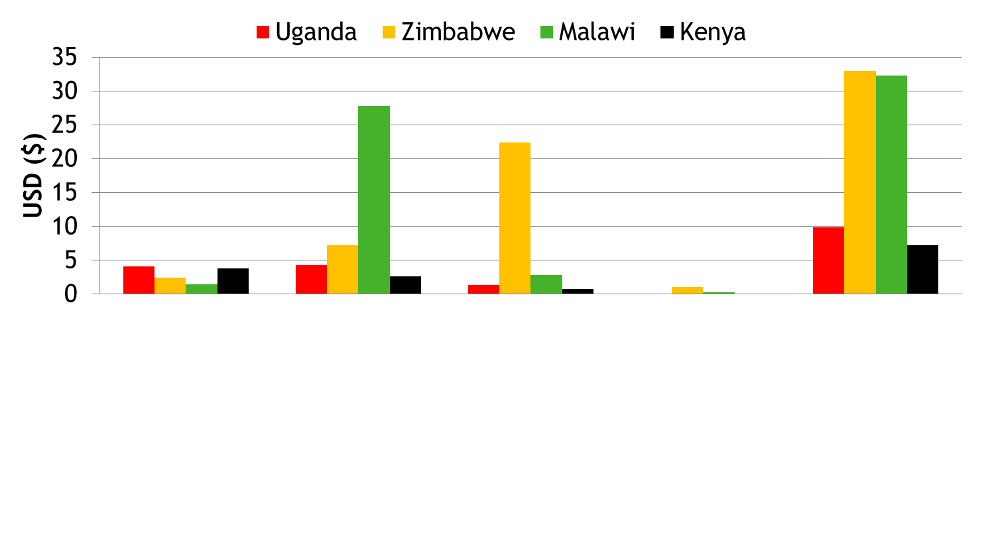
Drug costs for the 12 week enhanced prophylaxis package
Ranged from $7.16 (Kenya) to $32.99 (Zimbabwe)
* cost of INH borne by govt
*
*
12w INH/B6 (300mg/25mg)
12w fluconazole (100mg as split 200mg)
5d azithromycin (500mg)
1d albendazole (400mg)
Total
Cost-effectiveness analysis ongoing (incorporating costs saved from reduced hospitalisations)

Slide 19
Conclusions
In HIV-infected adults/children with CD4<100 cells/mm³
Enhanced prophylaxis at ART initiation
Reduced early mortality from 12.2% to 8.9% (25% relative reduction, 3.3% absolute reduction)
Reduced adverse events and hospitalisations
The additional pill burden did not adversely affect VL suppression and was decreased by a well-accepted FDC of CTX/INH/B6 (WHO pre-qualification in progress)
Policy-makers should consider adopting and implementing this low-cost broad infection prevention package which could save 3.3 lives for every 100 individuals treated

Slide 20
Acknowledgments
We thank all the patients and staff from all the centres participating in the REALITY trial.
Participating Centres: Joint Clinical Research Centre (JCRC), Kampala, Uganda (coordinating centre for Uganda): P Mugyenyi, C Kityo, V Musiime, P Wavamunno, E Nambi, P Ocitti, M Ndigendawani. JCRC, Fort Portal, Uganda: S Kabahenda, M Kemigisa, J Acen, D Olebo, G Mpamize, A Amone, D Okweny, A Mbonye, F Nambaziira, A Rweyora, M Kangah and V Kabaswahili . JCRC, Gulu,Uganda: J Abach, G Abongomera, J Omongin, I Aciro, A Philliam, B Arach, E Ocung, G Amone, P Miles, C Adong, C Tumsuiime, P Kidega, B Otto, F Apio. JCRC, Mbale, Uganda: K Baleeta, A Mukuye, M Abwola, F Ssennono, D Baliruno, S Tuhirwe, R Namisi, F Kigongo, D Kikyonkyo, F Mushahara, D Okweny, J Tusiime, A Musiime, A Nankya, D Atwongyeire, S Sirikye, S Mula, N Noowe. JCRC, Mbarara, Uganda: A Lugemwa, M Kasozi, S Mwebe, L Atwine, T Senkindu, T Natuhurira, C Katemba, E Ninsiima, M Acaku J Kyomuhangi, R Ankunda, D Tukwasibwe, L Ayesiga. University of Zimbabwe Clinical Research Centre, Harare, Zimbabwe: J Hakim, K Nathoo, M Bwakura-Dangarembizi, A Reid, E Chidziva, T Mhute, GC Tinago, J Bhiri, S Mudzingwa, M Phiri, J Steamer, R Nhema, C Warambwa, G Musoro, S Mutsai, B Nemasango, C Moyo, S Chitongo, K Rashirai, S Vhembo, B Mlambo, S Nkomani, B Ndemera, M Willard, C Berejena, Y Musodza, P Matiza, B Mudenge, V Guti. KEMRI Wellcome Trust Research Programme, Kilifi, Kenya: A Etyang, C Agutu, J Berkley, K Maitland, P Njuguna, S Mwaringa, T Etyang, K Awuondo, S Wale, J Shangala, J Kithunga, S Mwarumba, S Said Maitha, R Mutai, M Lozi Lewa, G Mwambingu, A Mwanzu, C Kalama, H Latham, J Shikuku, A Fondo, A Njogu, C Khadenge, B Mwakisha. Moi University Clinical Research Centre, Eldoret, Kenya: A Siika, K Wools-Kaloustian, W Nyandiko, P Cheruiyot, A Sudoi, S Wachira, B Meli, M Karoney, A Nzioka, M Tanui, M Mokaya, W Ekiru, C Mboya, D Mwimali, C Mengich, J Choge, W Injera, K Njenga, S Cherutich, M Anyango Orido,G Omondi Lwande, P Rutto, A Mudogo, I Kutto, A Shali, L Jaika, H Jerotich, M Pierre. Department of Medicine and MLW Clinical Research Programme, College of Medicine, Blantyre, Malawi: J Mallewa, S Kaunda, J Van Oosterhout, B O'Hare, R Heydermann, C Gonzalez, N Dzabala, C Kelly, B Denis, G Selemani, L Nyondo Mipando, E Chirwa, P Banda, L Mvula, H Msuku, M Ziwoya, Y Manda, S Nicholas, C Masesa , T Mwalukomo, L Makhaza, I Sheha, J Bwanali, M Limbuni.
Trial Coordination and Oversight: MRC Clinical Trials Unit at UCL, London, UK: D Gibb, M Thomason, AS Walker, S Pett, A Szubert, A Griffiths, H Wilkes, C Rajapakse, M Spyer, A Prendergast, N Klein.
Funders: REALITY is funded by Joint Global Health Trials Scheme of the UK Department for International Development (DFID), the Wellcome Trust and Medical Research Council (MRC). Additional funding support is provided by the PENTA foundation.
Merck Sharp & Dohme, Gilead Sciences, Cipla Ltd, ViiV Healthcare/GlaxoSmithKline donated drugs for REALITY and Valid International supplied Ready-to-Use-Supplementary-Food (RUSF).

