Slide 1
MDR-TB Update
Dr Kelvin Charambira
Programmatic Management of Drug Resistant TB (PMDT) Officer – The Union

Slide 2
MDR-TB Epidemiology
MDR-TB is a public health crisis and a global health security risk carrying grave consequences for those affected.
An estimated 580 000 people developed MDR/RR-TB in 2015 and 250 000 people died as a result of it.
Zimbabwe is one of the countries in the list of top 30 high burden MDR-TB cases
Preliminary TB drug resistant survey results indicate that about 4.2% and 14.2 % of new and previously treated cases, respectively, in Zimbabwe were estimated to be MDR-TB cases in 2015/16.

Slide 3
Drug Resistant-TB trends in Zimbabwe (2010-2016)
Districts notifying highest numbers – Gwanda, Matobo, Mangwe, Beitbridge, Tsholotsho, Lupane, Zvishavane, Mberengwa, Gweru, Hurungwe, Chiredzi, Seke, Bulawayo City

Slide 4
Age and sex distribution of RR/MDR-TB cases among notified cases (2015-2016)
Notes:
25-44 age group contributing more cases for both males and females

Slide 5
RR/MDR-TB and HIV
Routine surveillance data not very reliable due to lack of understanding of reporting tools on this indicator.
Preliminary findings on the recently ended TB DRS indicate;
 | HIV Positive | HIV Negative | HIV Status Unknown
MTB/Rif Res | 47 (73.4%) | 15 (23.4%) | 2 (3.1%)
MTB/Rif Sens | 585 (52.2%) | 493 (44.0%) | 42 (3.8%)
Notes:
Proportion of HIV positive higher for RR/MDR-TB compared to drug sensitive
MTB/Rif sensitive proportion of HIV positive lower than in routine surveillance

Slide 6
Notes:
Bulawayo City notifying more cases followed by Mat South
Midlands and Masvingo increasing trend

Slide 7
Notes:
Bulawayo and Chitungwiza showing higher rates
Harare showing very low rates

Slide 8
Notes:
Similar trend to 2015

Slide 9
RR/MDR-TB Treatment Outcomes (2011-2014 cohorts)
Notes:
Decentralisation and increased access to care resulted in weak case holding with decreasing treatment outcomes though the decline seems to be stabilising

Slide 10
Notes:
High death rate and not evaluated responsible for low treatment success

Slide 11
Notes:
High death rates in most provinces a cause of concer and responsible for low treatment success
LTFU rates high in Bulawayo, Chitungwiza, Mashonaland Central and Mashonaland East

Slide 12
MDR-TB – burden and treatment limitations
Outline
Only a quarter of these estimated cases are detected and treated
Of reported MDR-TB patients treated – only 50% are treated successfully
Currently recommended treatments are lengthy and often difficult to tolerate
* World Health Organization’s Global Tuberculosis Report 2015

Slide 13
‘Bangladesh’ Regimen
Daily treatment for 9 months
Months**
Drug
Kanamycin* 1-4
Isoniazid (H) 1-4
Prothionamide 1-4
Clofazimine 1-9
Gatifloxacin 1-9
Ethambutol 1-9
Pyrazinamide 1-9
* Kanamycin 3 times/week in month 4
** The intensive phase can be extended to 6 months

Slide 14
Results from Bangladesh Project
Published cohort (206 pts)
Cure 82.5%
Completion 5.3%
Default 5.8%
Death 5.3%
Failure 0.5%
Relapse 0.5%
Overall success rate:
87.9%
Am J Respir Crit Care Med 2010
Updated total (515 pts)
82.1%
2.3%
7.8%
5.6%
1.4%
0.8%
Overall success rate:
84.5%
Int J Tuberc Lung Dis 2014

Slide 15
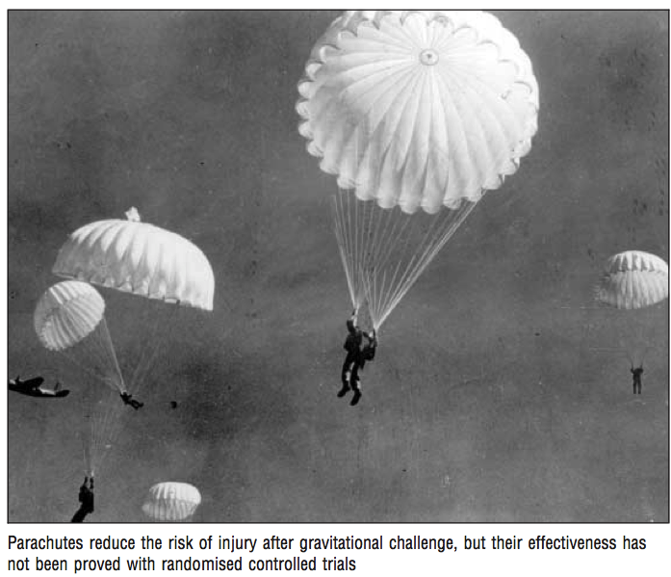
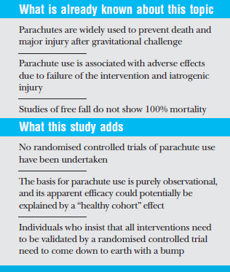
Smith GSC, Pell J. BMJ. 2003

Slide 16
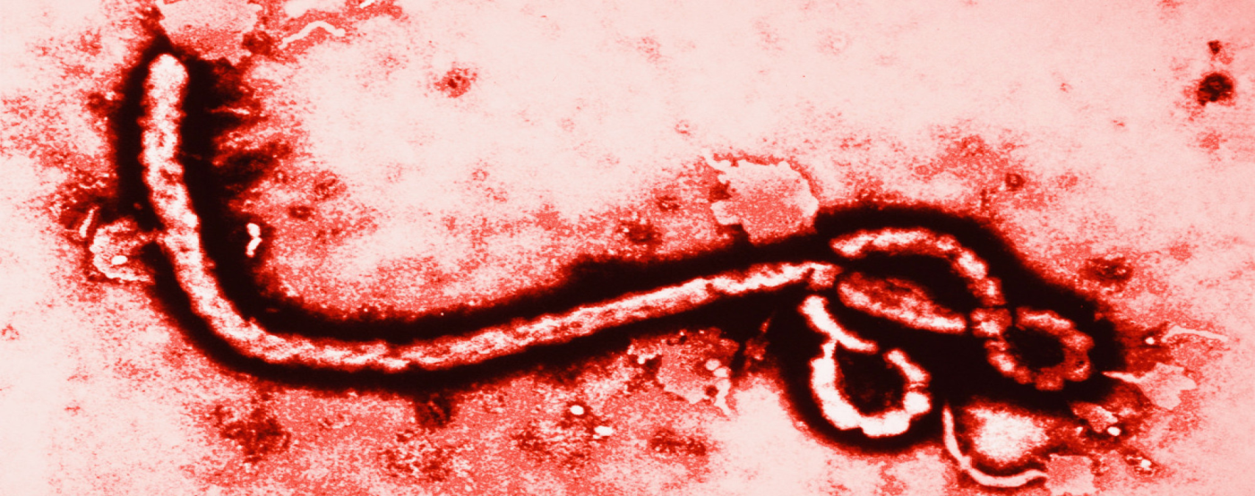
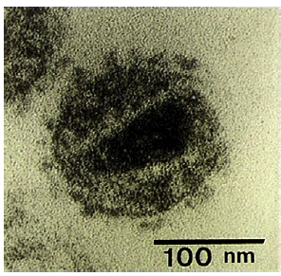
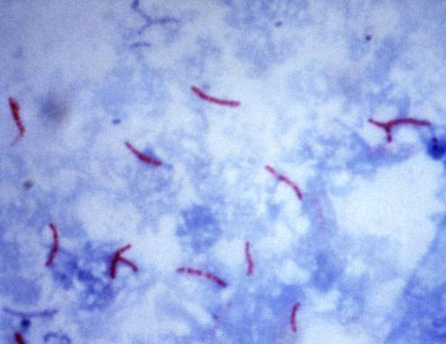
TB is simply an airborne illness
Anyone
can have
TB
THANK YOU!!

